Slide 1
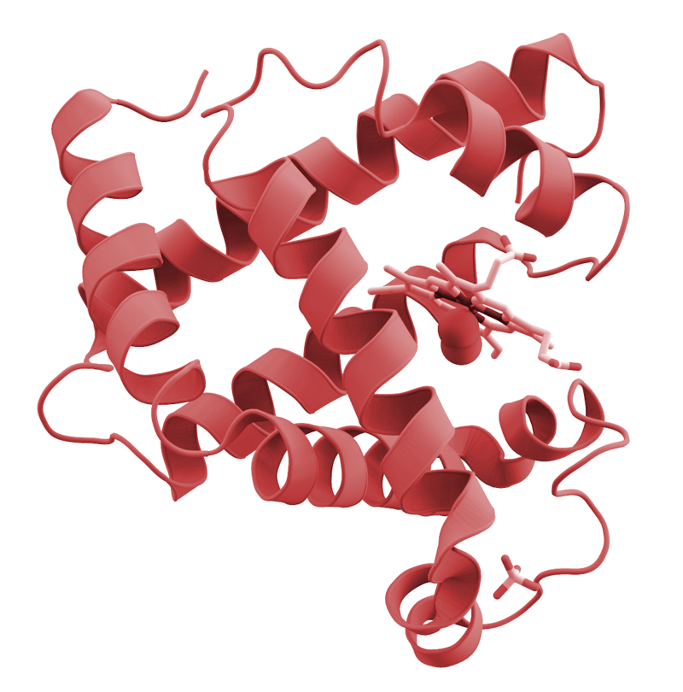

React
Feature Testing using
Enzyme
Notes:
Feature-Driven Component Testing

Slide 2
POP QUIZ (Again)
Notes:
Why TDD?

Slide 3

Feature Testing So Far
Can use Capybara to interact with static web pages
Visit Link, Fill In Form With Info, Click Button
Expect Page to have Content
Composed of feature/scenario “blocks”
Can run JS code using libraries such as capybara-webkit, selenium, and poltergeist

Slide 4
Problems with Feature Testing Javascript in Capybara
Lack of ES6 Support for Ruby Apps
No fetch (Only Ajax)
No import (No access to node modules)
Most Importantly, no React Components
Multiple JS File Dependency Issues
Can use webpack (module bundler) and babel (es6 transpiler) to create static bundle.js file
Keep testing specifically on the component level
Solution…?

Slide 5
Enzyme!
...and friends
Notes:
Javascript Library used to traverse and Test React components

Slide 6
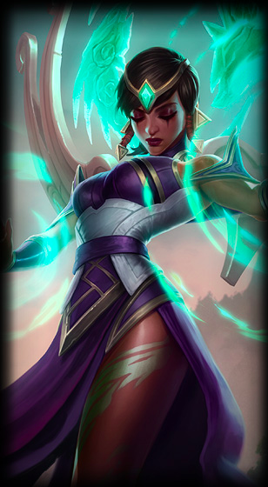

Karma - JS Test Runner
Write Code -> Instant Feedback
Launches HTTP Server and runs JS code
Uses PhantomJS as headless web browser
Compatible with Jasmine
Jasmine is what we use to write our JS Test Code
Composed of It/Describe “blocks”
Notes:
Headless - no GUI

Slide 7
Karma Configuration
$ npm install --save-dev jasmine-core karma karma-jasmine
Install Jasmine, Karma, and enables Jasmine in Karma
$ npm install --save-dev karma-phantomjs-launcher phantomjs-prebuilt
Install PhantomJS and runs when Karma runs
$ npm install -g karma-cli
Allow karma to run from terminal
karma.conf.js and package.json, then either karma start or npm test

Slide 8
Testing React Components - Setup
We need a bit of setup for testing each individual React Component
TestHelper.js
Import all necessary modules/functions (React, jasmineEnzyme, mount/shallow from enzyme )
Assign each module to every object for use
jasmineEnzyme() to enable matchers
Require all relevant files (test.js files and our Components we’re testing

Slide 9
Testing Stateless Components
Create a wrapper with our React Component
DOM-less representation of what the Component renders (JSX)
Can test for the existence of html tags including their properties (images) and text
Use `jasmine.createSpy` and simulate on event handlers
Creates capability of function to be called
Use and.callThrough() on to execute the functionality of the spied on function
Notes:
Jasmine has test double functions called spies. A spy can stub any function and tracks calls to it and all arguments.

Slide 10
Testing Stateful Components
Same setup as stateless components
Create a wrapper for your Stateful component
Can test the state
expect(wrapper.state()).toEqual({ hasBird: false });
Check for existence and props of children components (also possible on stateless)
expect(wrapper.find(Capybara)).toBePresent();
expect(wrapper.find(Capybara).props()).toEqual({..})
Notes:
Capybara, LAFAQ, Hogwarts examples

Slide 11
Testing Stateful Components (Events)
spyOn now must be called on the prototype of the component
Use `.and.callThrough()` to execute the state change defined in the function called
spyOn(CapybaraContainer.prototype, 'handleClick').and.callThrough();
Can now execute `onClick` or other event that handles the event
Can also do this for the children of the component if the eventhandler is passed in as a property

Slide 12
Shallow Rendering vs. Full DOM Rendering
Stateless/Stateful
Represents DOM elements and children components
Shallow Rendering
Unmounted to DOM (tests run faster)
Does not include rendered trees of child components
Full DOM Rendering
Can Call Lifecycle Methods
componentDidMount
Can Check for rendered tree of children components
Can check for DOM specific events (alert)
Notes:
Quick explanation of lifecycle methods

Slide 13
Quick Code Example (with Debugging With Sourcemap)

Slide 14
Recap
Use Karma to run Jasmine-Enzyme tests
Can now test on React code on the component level
Can test for rendered elements with shallow wrappers
Test html, text, properties, and child Components
Can create spies to test event handlers
Full Dom wrappers to test DOM events and lifecycle methods
Notes:
Capybara, LAFAQ, Hogwarts examples

Slide 15
The tools you now have
RSpec - Unit Testing for Ruby Code
Capybara - Feature Testing Sinatra Apps
Jasmine - Unit Testing Javascript Code
Enzyme - Feature/Component Testing React Code

Slide 16
Thanks!
Any questions ?
Add Tests for LA FAQ
Optional Challenge
Quiz

